Slide 1
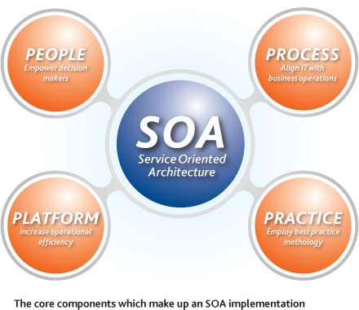
Web Services and SOA
Take the code to the Server
Data Structures and Algorithms
Telerik Software Academy
http://academy.telerik.com

Slide 2

Table of Contents
The Need for Service-Oriented Applications
Service-Oriented Architecture (SOA)
SOA and Web 2.0
Classical Web Services and Protocols
SOAP, WSDL, HTTP, XML
WS-MetadataExchange
RESTful Web Services

Slide 3


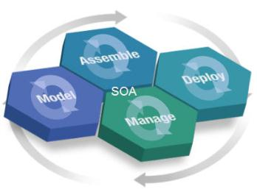
The Need for Service-Oriented (SOA) Applications

Slide 4
Distributed Applications
Most of the modern applications are distributed
Consist of several smaller components which interact with each other
Distributed application models
"Client-Server" model
"Distributed objects" model
DCOM – used in Microsoft Windows
CORBA – open standard, very complex
Java RMI – based on the Java technology
.NET Remoting – used in early .NET Framework
"Web services" / "RESTful Web services" model

Slide 5
What is a Service?
In the real world a "service" is:
A piece of work performed by a service provider
Provides a client (consumer) some desired result by some input parameters
The requirements and the result are known
Easy to use
Always available
Has quality characteristics (price, execution time, constraints, etc.)

Slide 6
Service-Oriented Applications
Service-oriented applications resemble the service-consumer model in the real world
Consist of service provider (server side) and service consumer (client part)
Typical examples are the RIA
Service providers provide some service
Service consumers access the services
Standard protocols are used like XML, JSON, SOAP, WSDL, RSS, HTTP, …

Slide 7
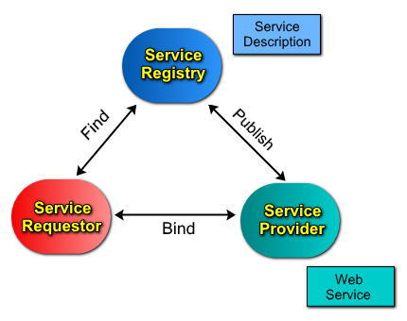


Service-Oriented Architecture (SOA)

Slide 8
What is SOA?
SOA (Service-oriented Architecture) is a concept for development of software systems
Using reusable building blocks (components) called "services"
Services in SOA are:
Autonomous
Stateless business functions
Accept requests and return responses
Use well-defined, standard interface

Slide 9
SOA Services
Autonomous
Each service operates autonomously
Without any awareness that other services exist
Stateless
Have no memory, do not remember state
Easy to scale
Request-response model
Client asks, server returns an answer

Slide 10
SOA Services (2)
Communication through standard protocols
XML, SOAP, JSON, RSS, ...
HTTP, FTP, SMTP, RPC, MSMQ, ...
Not dependent on OS, platforms, programming languages
Discoverable
Service registries

Slide 11
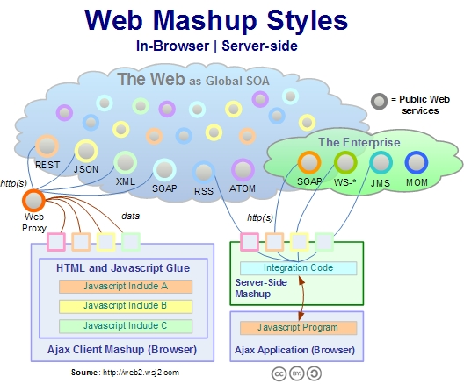
SOA and Web 2.0

Slide 12
SOA and Web 2.0
Moving to a "services model" – global IT trend for both:
Internet business
Inside an enterprise
Two main SOA scenarios
SOA in Internet
Software as service, Web 2.0, RIA, ...
SOA inside an enterprise
Heavy SOA stacks: WS-*, BPM, BPEL, ESB, ...

Slide 13
SOA in Internet
Internet companies implement lightweight SOA in Internet
Also called WOA (Web-Oriented Architecture)
Examples:
Google, Amazon, Facebook, Twitter, ...
Tend to provide software as service
Based on lightweight Web standards:
AJAX and Rich Internet Applications (RIA)
REST, XML, RSS, JSON, proprietary APIs

Slide 14
SOA in Enterprises
Heavyweight SOA stacks
Driven by business processes: BPM, BPMN, BPEL, ...
Enterprise application integration (EAI)
B2B integration
SOA based portals
Unified Frameworks: SCA and WCF
Enterprise Service Bus (ESB)
SOA governance (control)

Slide 15
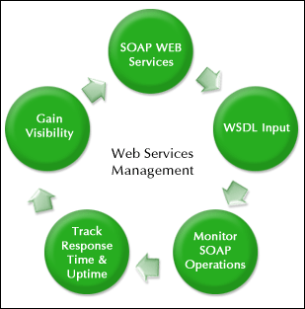

Web Services Infrastructure
SOAP / WSDL / HTTP / XML

Slide 16
Web Services
Web services model real life services
Program components that can be accessed remotely through the Web
Execution model “request-result”
A client requests, the service executes the request and delivers a result
Use open communication standards
HTTP, XML, JSON and SOAP
Describe their interface in WSDL language

Slide 17
Web Services (2)
Web services work by exchanging SOAP messages
Messages contain structured info: data + metadata
Independent from the OS, the platform and the programming language
Loosely coupled

Slide 18
Web Services Infrastructure
The infrastructure of Web Services consists of the following components:
Description
WSDL – Web Server Definition Language
Metadata
DISCO and WS-MetadataExchange
Wire format
SOAP, XML, XSD
HTTP

Slide 19
WSDL Service Description
WSDL (Web Services Description Language)
Describes what a Web service can do
Names of the available methods
Input and output parameters, returned value
Data types used for parameters or result
XML based, open standard of W3C
ASP.NET Web services return their WSDL when called with ?wsdl suffix
http://localhost/MyService.asmx?wsdl

Slide 20
WSDL – Example
<?xml version="1.0" encoding="utf-8"?>
<definitions
xmlns:http="http://schemas.xmlsoap.org/wsdl/http/"
xmlns:soap="http://schemas.xmlsoap.org/wsdl/soap/"
xmlns:s="http://www.w3.org/2001/XMLSchema"
xmlns:s0="http://www.devbg.org/ws/MathService"
xmlns:soapenc="http://schemas.xmlsoap.org/soap/encoding/"
xmlns:tm="http://microsoft.com/wsdl/mime/textMatching/"
xmlns:mime="http://schemas.xmlsoap.org/wsdl/mime/"
targetNamespace="http://www.devbg.org/ws/MathService"
xmlns="http://schemas.xmlsoap.org/wsdl/">
<types> … </types>
<message name="AddSoapIn"> … </message>
<portType name="MathServiceSoap"> … </portType>
<binding name="MathServiceSoap" … > … </binding>
<service name="MathService"> … </service>
</definitions>

Slide 21
Discovery of Web Service
The process of getting the service metadata (description)
Usually a URL is interrogated to retrieve the metadata
Two protocols for interrogation
DISCO – old Microsoft protocol to use with the UDDI registry idea
WS-MetadataExchange – new standardized protocol developed by Microsoft, Sun, SAP, …

Slide 22
SOAP – Request/Result Format
SOAP (Simple Object Access Protocol)
Open XML based format for sending messages
Open standard of W3C
A SOAP message consists of:
SOAP header – describes the parameters of the message (metadata)
SOAP body – contains the very message (data – the request or the result)
Usually SOAP messages are sent over HTTP
They can bypass firewalls that way

Slide 23
SOAP Request – Example
<?xml version="1.0" encoding="utf-8"?>
<soap:Envelope
xmlns:xsi="http://www.w3.org/2001/XMLSchema-instance"
xmlns:xsd="http://www.w3.org/2001/XMLSchema"
xmlns:soap="http://schemas.xmlsoap.org/soap/envelope/">
<soap:Body>
<CalcDistance xmlns="http://www.devbg.org/Calc">
<startPoint>
<x>4</x>
<y>5</y>
</startPoint>
<endPoint>
<x>7</x>
<y>-3</y>
</endPoint>
</CalcDistance>
</soap:Body>
</soap:Envelope>

Slide 24
SOAP Result – Example (2)
<?xml version="1.0" encoding="utf-8"?>
<soap:Envelope
xmlns:xsi="http://www.w3.org/2001/XMLSchema-instance"
xmlns:xsd="http://www.w3.org/2001/XMLSchema"
xmlns:soap="http://schemas.xmlsoap.org/soap/envelope/">
<soap:Body>
<CalcDistanceResponse
xmlns="http://www.devbg.org/Calc/">
<CalcDistanceResult>
8,54400374531753
</CalcDistanceResult>
</CalcDistanceResponse>
</soap:Body>
</soap:Envelope>

Slide 25
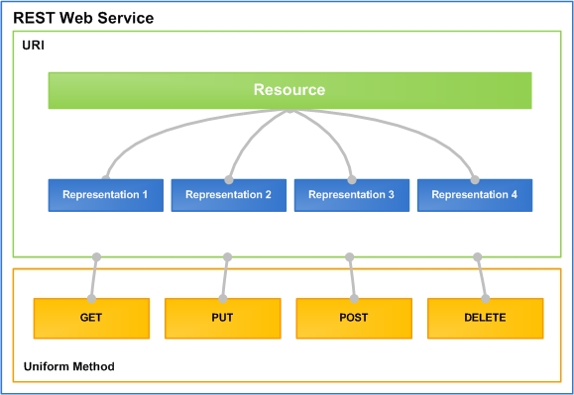
RESTful Web Services
Lightweight Architecture for Web Services

Slide 26
What is REST?
“Representational state transfer (REST) is a style of software architecture for distributed hypermedia systems such as the World Wide Web.”
http://en.wikipedia.org/wiki/Representational_State_Transfer
Application state and functionality are resources
Every resource has an URI
All resources share a uniform interface
This natively maps to the HTTP protocol

Slide 27
RESTful Services
One URI for a resource, multiple operations
Add a new document "RestTalk" in category "Code"
POST http://mysite.com/docs/Code/RestTalk
Get the document / some page
GET http://mysite.com/docs/Code/RestTalk
GET http://mysite.com/docs/Code/RestTalk/pages/3
Remove the document
DELETE http://mysite.com/docs/Code/RestTalk
Retrieve metadata
HEAD http://mysite.com/docs/Code/RestTalk

Slide 28
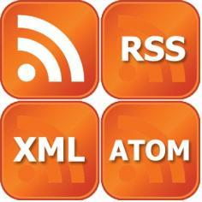
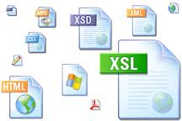

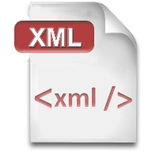


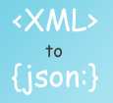

XML, JSON, RSS
Comparing the Common Service Data Formats

Slide 29
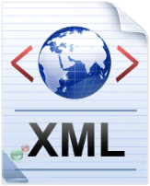
XML
XML is markup-language for encoding documents in machine-readable form
Text-based format
Consists of tags, attributes and content
Provide data and meta-data in the same time
<?xml version="1.0"?>
<library>
<book><title>HTML 5</title><author>Bay Ivan</author></book>
<book><title>WPF 4</title><author>Microsoft</author></book>
<book><title>WCF 4</title><author>Kaka Mara</author></book>
<book><title>UML 2.0</title><author>Bay Ali</author></book>
</library>

Slide 30
JSON
JSON (JavaScript Object Notation)
Standard for representing simple data structures and associative arrays
Lightweight text-based open standard
Derived from the JavaScript language
{
"firstName": "John", "lastName": "Smith", "age": 25,
"address": { "streetAddress": "33 Alex. Malinov Blvd.",
"city": "Sofia", "postalCode": "10021" },
"phoneNumber": [{ "type": "home", "number": "212 555-1234"},
{ "type": "fax", "number": "646 555-4567" }]
},
{ "firstName": "Bay", "lastName": "Ivan", "age": 79 }

Slide 31

RSS
RSS (Really Simple Syndication)
Family of Web feed formats for publishing frequently updated works
E.g. blog entries, news headlines, videos, etc.
Based on XML, with standardized XSD schema
RSS documents (feeds) are list of items
Each containing title, author, publish date, summarized text, and metadata
Atom protocol aimed to enhance / replace RSS

Slide 32
RSS – Example
<?xml version="1.0" encoding="utf-8" ?>
<rss version="2.0">
<channel>
<title>W3Schools Home Page</title>
<link>http://www.w3schools.com</link>
<description>Free web building tutorials</description>
<item>
<title>RSS Tutorial</title>
<link>http://www.w3schools.com/rss</link>
<description>New RSS tutorial on W3Schools</description>
</item>
<item>
<title>XML Tutorial</title>
<link>http://www.w3schools.com/xml</link>
<description>New XML tutorial on W3Schools</description>
</item>
</channel>
</rss>

Slide 33
SOA Architecture

Slide 34
Service-oriented Architecture
SOA is build on the request-response pattern
Architecture decoupling application's business and UI logic
Business logic on a server
In the form of web services
UI logic on the client
Web client, desktop client, mobile client
Written in JavaScript, C#, Java, PHP, etc…

Slide 35
Service-oriented Architecture (2)
The business logic (app logic) is located on a server
The client accesses the business logic by sending a request
The server receives the request, computes it and returns to the client a response
The client updates its UI based on the server response

Slide 36
Service-oriented Architecture (3)
Server
Web Client
$.post("server/register", credentials, 'json');
Auth
Register
$.post("server/login", credentials, 'json');
Login
$.getJSON("server/users");
Operations
Desktop client
Users
httpRequest =
HttpRequest.create("server/users");
response = httpRequest.getResponse();
//parse response to C# objects
Add User
Remove User

Slide 37
Web Service Clients

Slide 38
Web Service Clients
Web service clients can be of any type or in any platform
If not explicitly limited
REST services can be access by JavaScript, C#, Java, Node.js or any other language
RESTful web services provide a high level of code reusability
Code the business logic once, develop clients for different applications

Slide 39
Web Services, RESTful Web Services and SOA
?
?
?
?
?
Questions?
?
?
?
?
?

